Slide 1
St. Louis Central Corridor West Building Permits
Monthly Report: August 2021

Slide 2
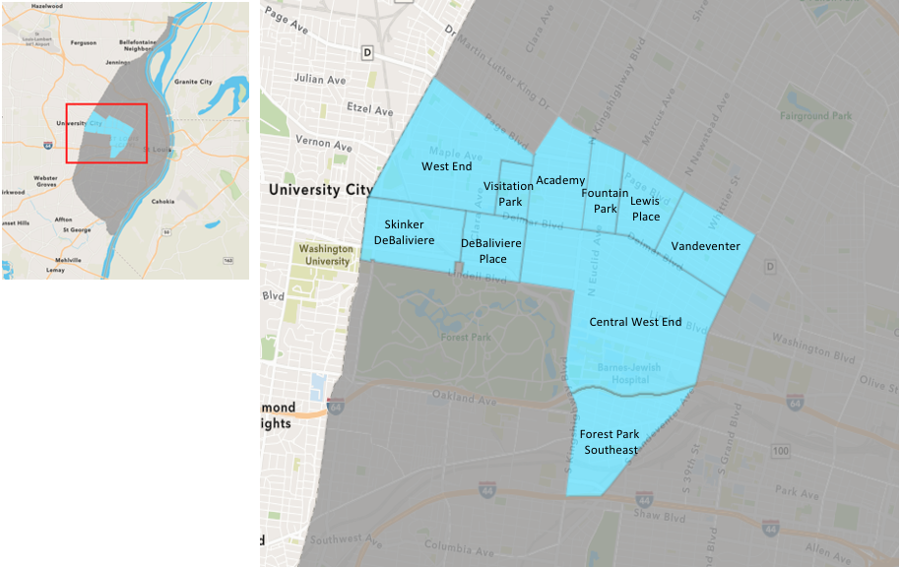
St. Louis Neighborhood Spatial Reference

Slide 3
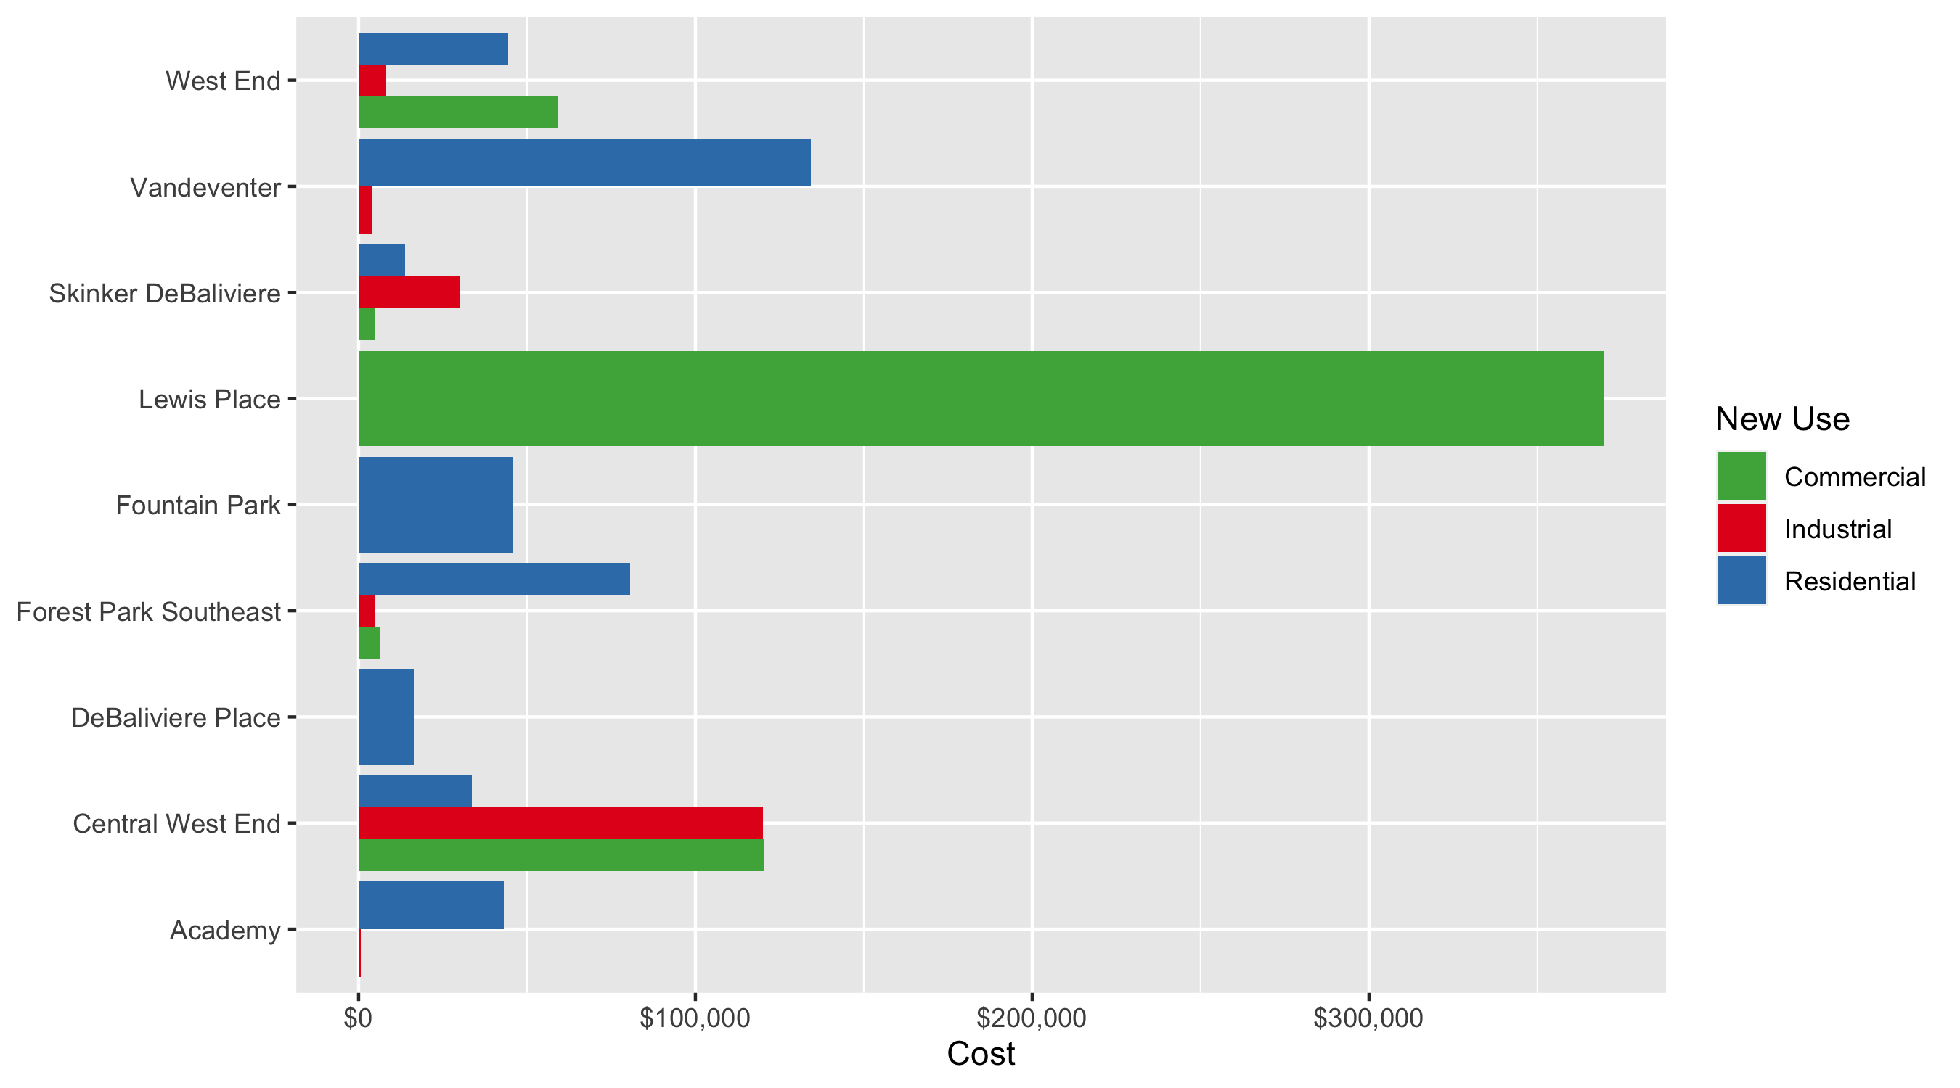
Neighborhood Summary: Average Building Permit Cost

Slide 4
Neighborhood Summary
August 2021 | August 2021 | August 2021 | August 2021
Neighborhood | Average Cost | # of Permits | Total Value of Permits
Academy | $32,558.00 | 4 | $130,232
Central West End | $62,430.27 | 30 | $1,872,908
DeBaliviere Place | $16,418.50 | 4 | $65,674
Forest Park Southeast | $68,749.89 | 19 | $1,306,248
Fountain Park | $45,845.00 | 2 | $91,690
Lewis Place | $369,778.67 | 3 | $1,109,336
Skinker DeBaliviere | $13,642.86 | 7 | $95,500
Vandeventer | $101,750.00 | 4 | $407,000
Visitation Park | $0.00 | 0 | $0
West End | $51,370.55 | 20 | $1,027,411
Last 6 Months | Last 6 Months | Last 6 Months | Last 6 Months
Neighborhood | Average Cost | # of Permits | Total Value of Permits
Academy | $41,281.50 | 50 | $2,064,075
Central West End | $793,457.88 | 626 | $496,704,636
DeBaliviere Place | $198,002.79 | 80 | $15,840,223
Forest Park Southeast | $385,053.21 | 227 | $87,407,079
Fountain Park | $337,772.70 | 20 | $6,755,454
Lewis Place | $61,463.04 | 27 | $1,659,502
Skinker DeBaliviere | $402,110.76 | 169 | $67,956,719
Vandeventer | $49,689.09 | 23 | $1,142,849
Visitation Park | $16,747.00 | 7 | $117,229
West End | $206,297.84 | 162 | $33,420,250

Slide 5
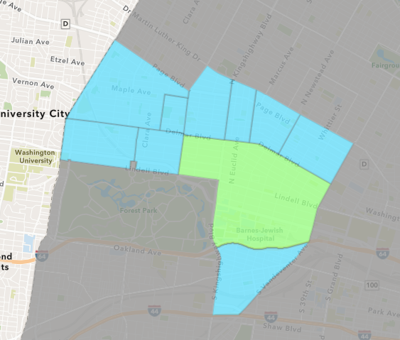
Central West End
August 2021 Neighborhood Cost Breakdown
Mean: $62,430
Median: $28,500
Range: $1,414 - $725,000

Slide 6
Central West End: Summary Notes
30 building permits in August 2021
-18.92% change compared to August 2020 (37 total building permits)
$62,430: Average building permit cost in August 2021
-92.05% change compared to August 2020 ($785,169)
282 total building permits in 2021
11.02% change YTD compared to this time in 2020 (254 total building permits)
$1,283,796: YTD average building permit cost in 2021
272.34% change YTD compared to this time in 2020 ($344,795)

Slide 7
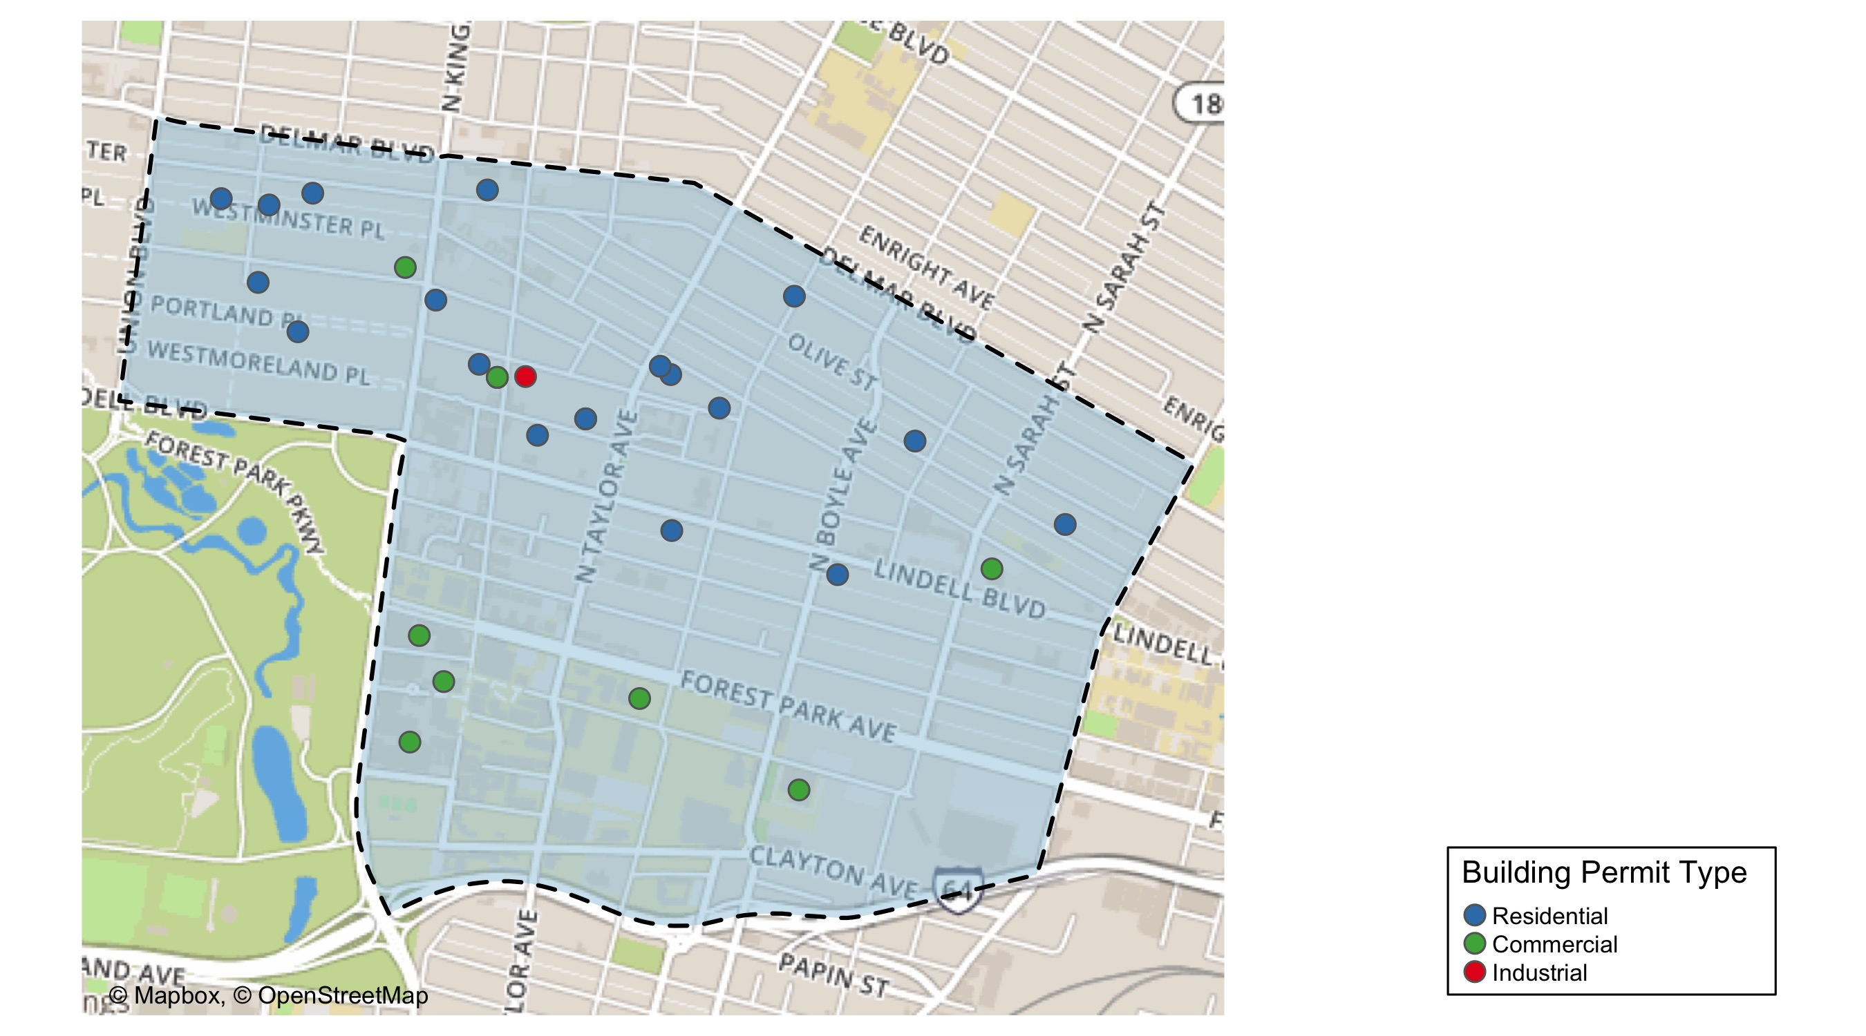
Central West End

Slide 8
Neighborhood Summary
August 2021 | August 2021 | August 2021 | August 2021
Permit Use | Average Cost | # of Permits | Total Value of Permits
Commercial | $120,228.56 | 9 | $1,082,057
Industrial | $120,000.00 | 1 | $120,000
Residential | $33,542.55 | 20 | $670,851
Last 6 Months | Last 6 Months | Last 6 Months | Last 6 Months
Permit Use | Average Cost | # of Permits | Total Value of Permits
Commercial | $1,467,305 | 275 | $403,508,807
Industrial | $1,243,170 | 27 | $33,565,583
Residential | $184,044 | 324 | $59,630,246

Slide 9
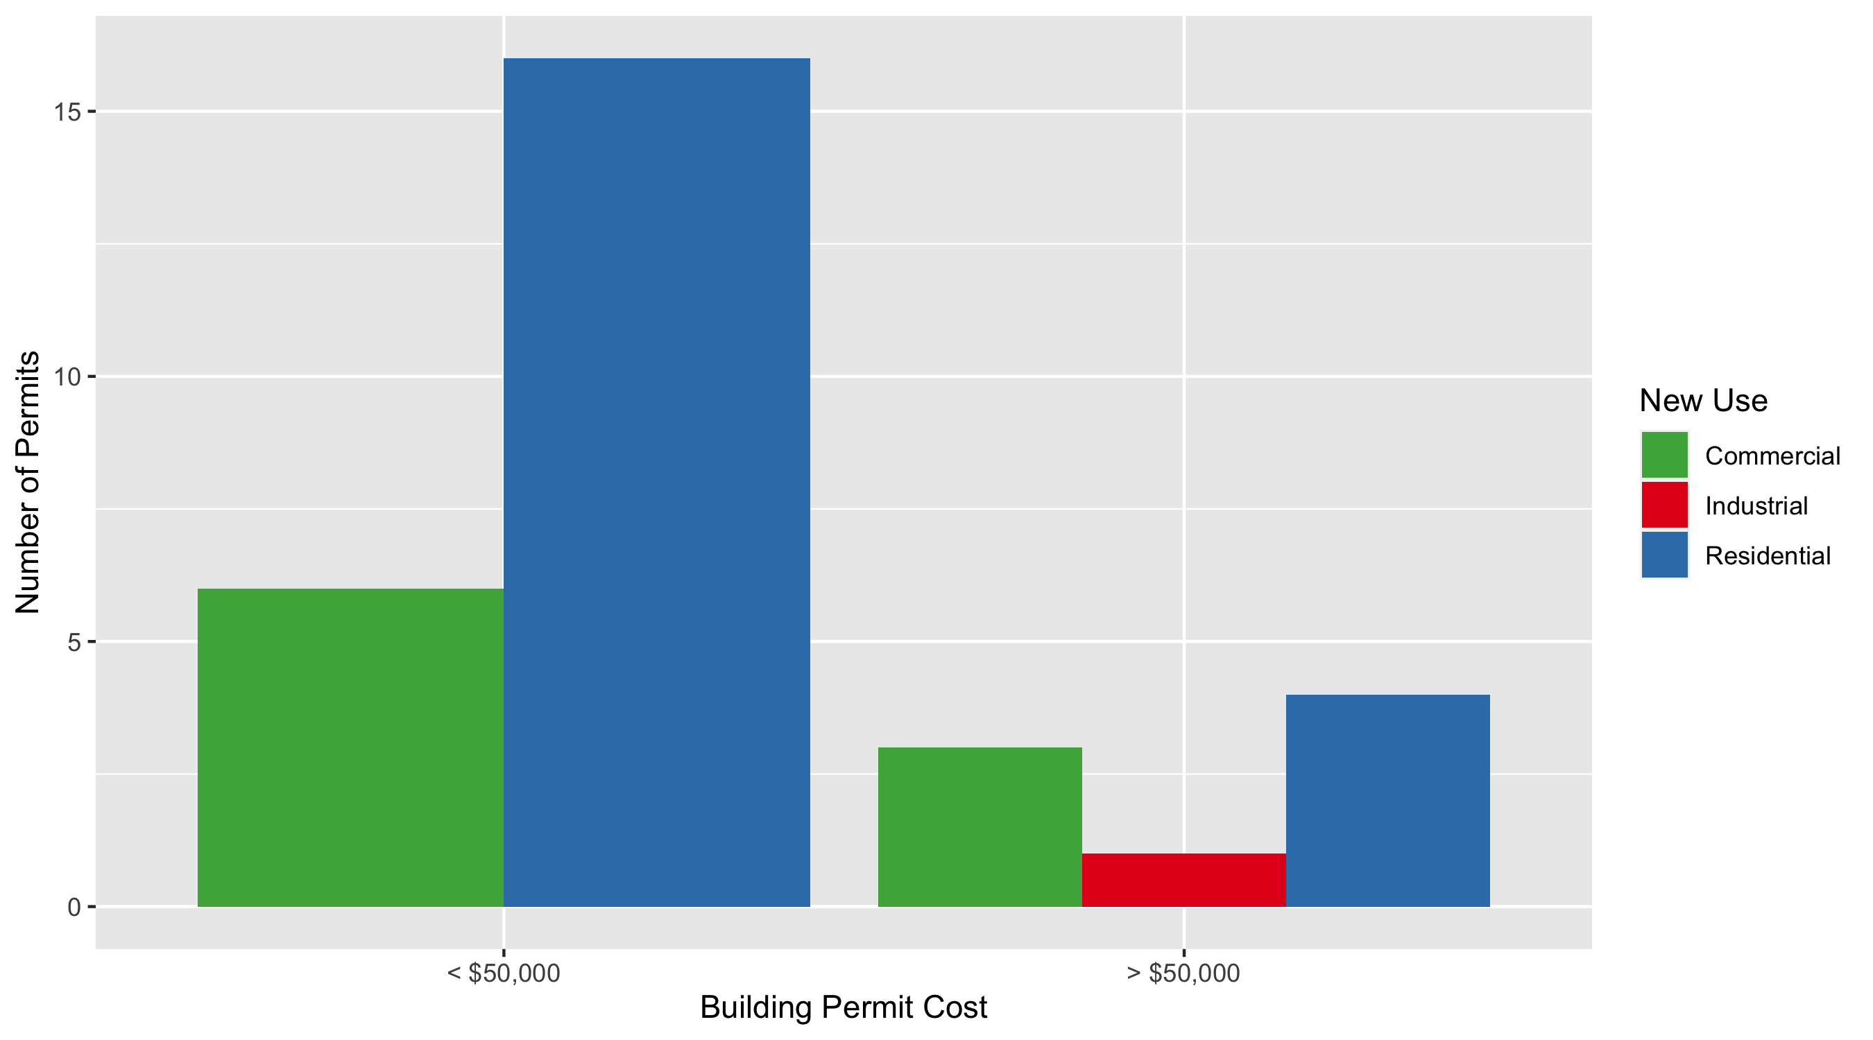
Central West End Permit Cost Breakdown

Slide 10
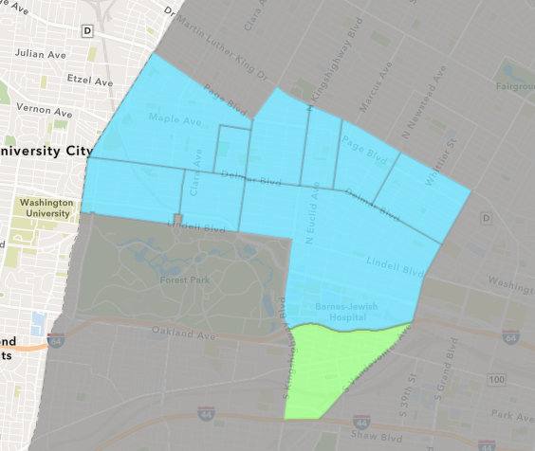
Forest Park Southeast
August 2021 Neighborhood Cost Breakdown
Mean: $68,750
Median: $20,000
Range: $2,000 - $400,000

Slide 11
Forest Park Southeast: Summary Notes
19 building permits in August 2021
171.43% change compared to August 2020 (7 total building permits)
$68,750: Average building permit cost in August 2021
372.74% change compared to August 2020 ($14,543)
122 total building permits in 2021
67.12% change YTD compared to this time in 2020 (73 total building permits)
$506,305: YTD average building permit cost in 2021
137.16% change YTD compared to this time in 2020 ($213,486)

Slide 12
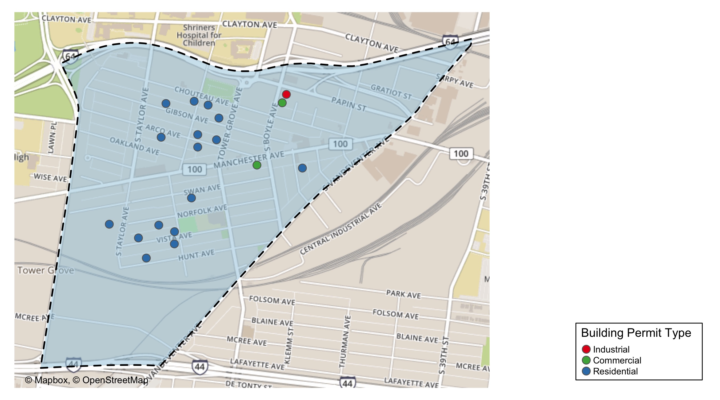
Forest Park Southeast

Slide 13
Neighborhood Summary
August 2021 | August 2021 | August 2021 | August 2021
Permit Use | Average Cost | # of Permits | Total Value of Permits
Commercial | $6,300.0 | 2 | $12,600
Industrial | $5,000.0 | 1 | $5,000
Residential | $80,540.5 | 16 | $1,288,648
Last 6 Months | Last 6 Months | Last 6 Months | Last 6 Months
Permit Use | Average Cost | # of Permits | Total Value of Permits
Commercial | $428,906.82 | 61 | $26,163,316
Industrial | $62,212.67 | 15 | $933,190
Residential | $399,407.77 | 151 | $60,310,573

Slide 14
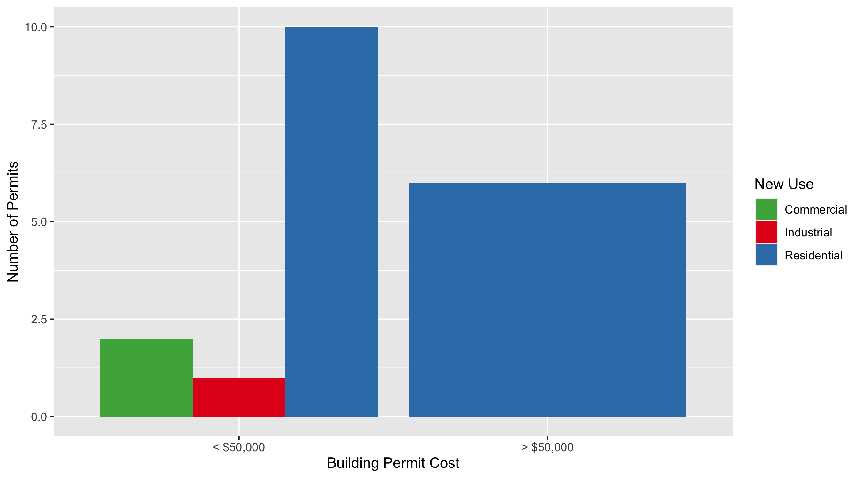
Forest Park Southeast Permit Cost Breakdown

Slide 15
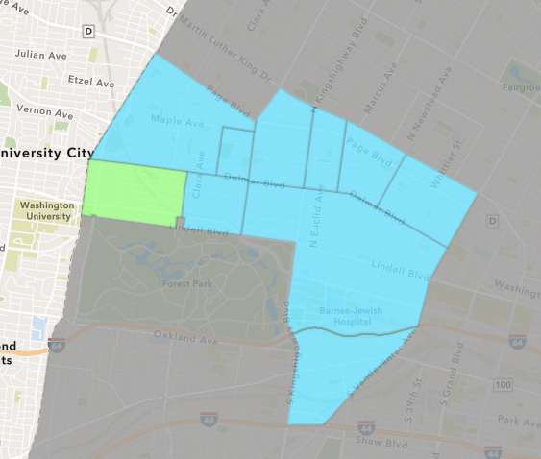
Skinker DeBaliviere
August 2021 Neighborhood Cost Breakdown
Mean: $13,643
Median: $8,500
Range: $1,500 - $30,000

Slide 16
Skinker DeBaliviere: Summary Notes
7 building permits in August 2021
-41.67% change compared to August 2020 (12 total building permits)
$13,643: Average building permit cost in August 2021
-83.96% change compared to August 2020 ($85,067)
65 total building permits in 2021
-15.58% change YTD compared to this time in 2020 (77 total building permits)
$27,058: YTD average building permit cost in 2021
-96.65% change YTD compared to this time in 2020 ($808,807)

Slide 17
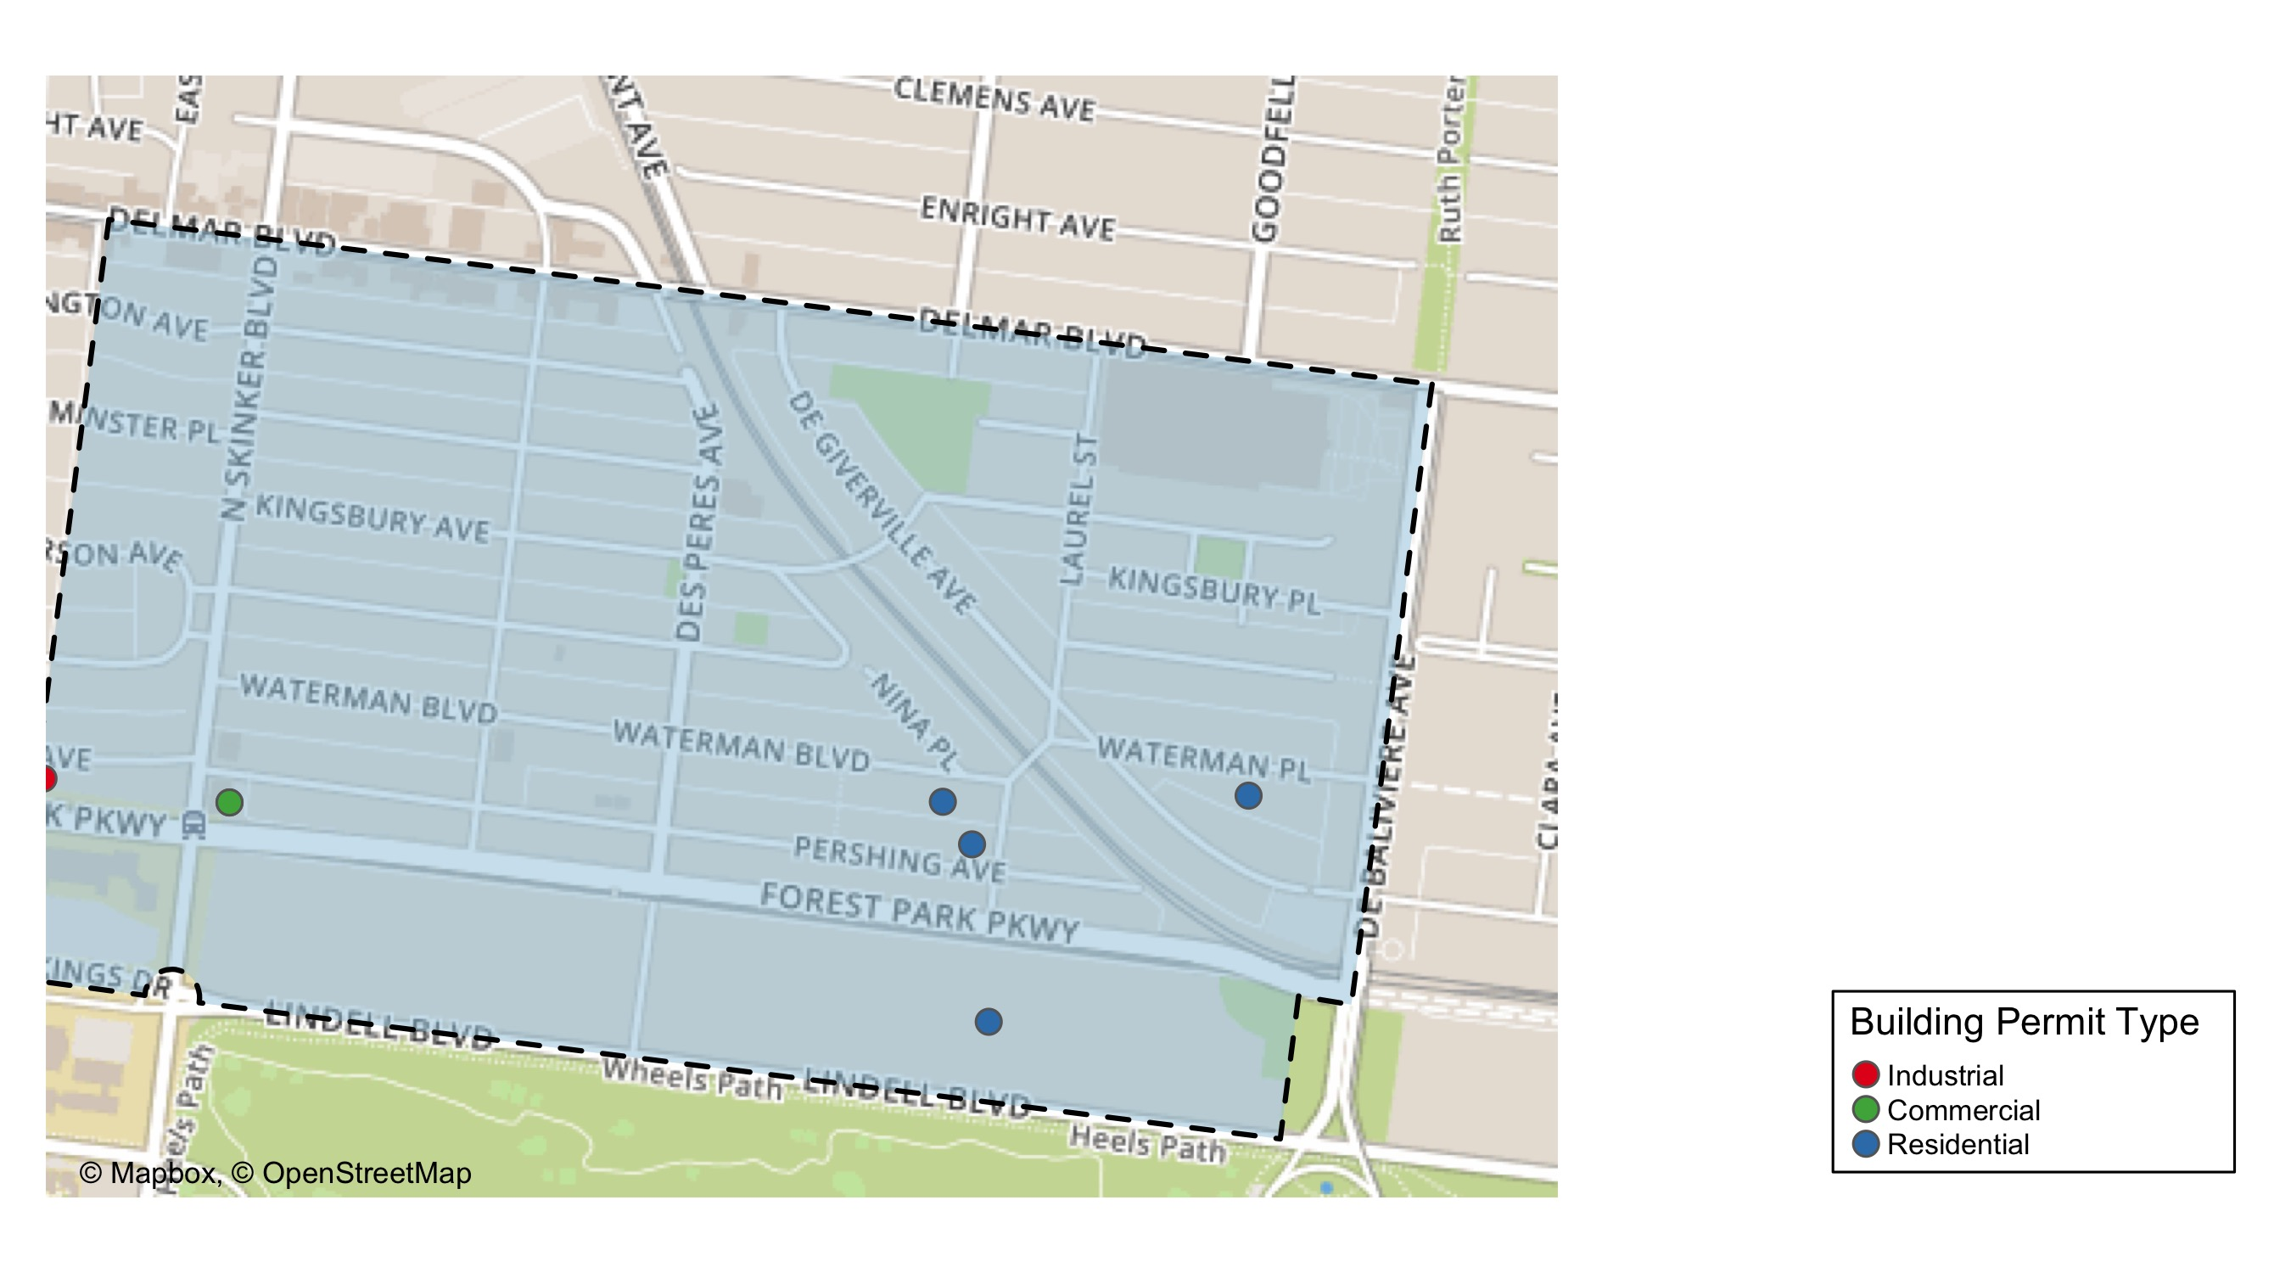
Skinker DeBaliviere

Slide 18
Neighborhood Summary
August 2021 | August 2021 | August 2021 | August 2021
Permit Use | Average Cost | # of Permits | Total Value of Permits
Commercial | $5,000 | 2 | $10,000
Industrial | $30,000 | 1 | $30,000
Residential | $13,875 | 4 | $55,500
Last 6 Months | Last 6 Months | Last 6 Months | Last 6 Months
Permit Use | Average Cost | # of Permits | Total Value of Permits
Commercial | $3,175,382.79 | 19 | $60,332,273
Industrial | $16,692.86 | 7 | $116,850
Residential | $52,500.67 | 143 | $7,507,596

Slide 19
Skinker DeBaliviere Individual Permit Breakdown
nbhd_name | Owner | New Use | Cost | address
Skinker DeBaliviere | WASHINGTON UNIVERSITY P | Commercial | $8,500 | 282 N SKINKER BLVD
Skinker DeBaliviere | DORN, KARLA A | Industrial | $30,000 | 6254 PERSHING AV
Skinker DeBaliviere | BRINKLEY, CYNTHIA J | Residential | $24,000 | 5795 LINDELL BLVD
Skinker DeBaliviere | LAND, LEATA C PRICE & JACQUE M | Residential | $3,000 | 5820 WATERMAN BLVD
Skinker DeBaliviere | CLARK, COURTNEY R | Residential | $8,500 | 5809 PERSHING AV
Skinker DeBaliviere | WASHINGTON UNIVERSITY P | Commercial | $1,500 | 282 N SKINKER BLVD
Skinker DeBaliviere | COOPER, DEBORAH LYNN | Residential | $20,000 | 5744 WATERMAN BLVD

Slide 20
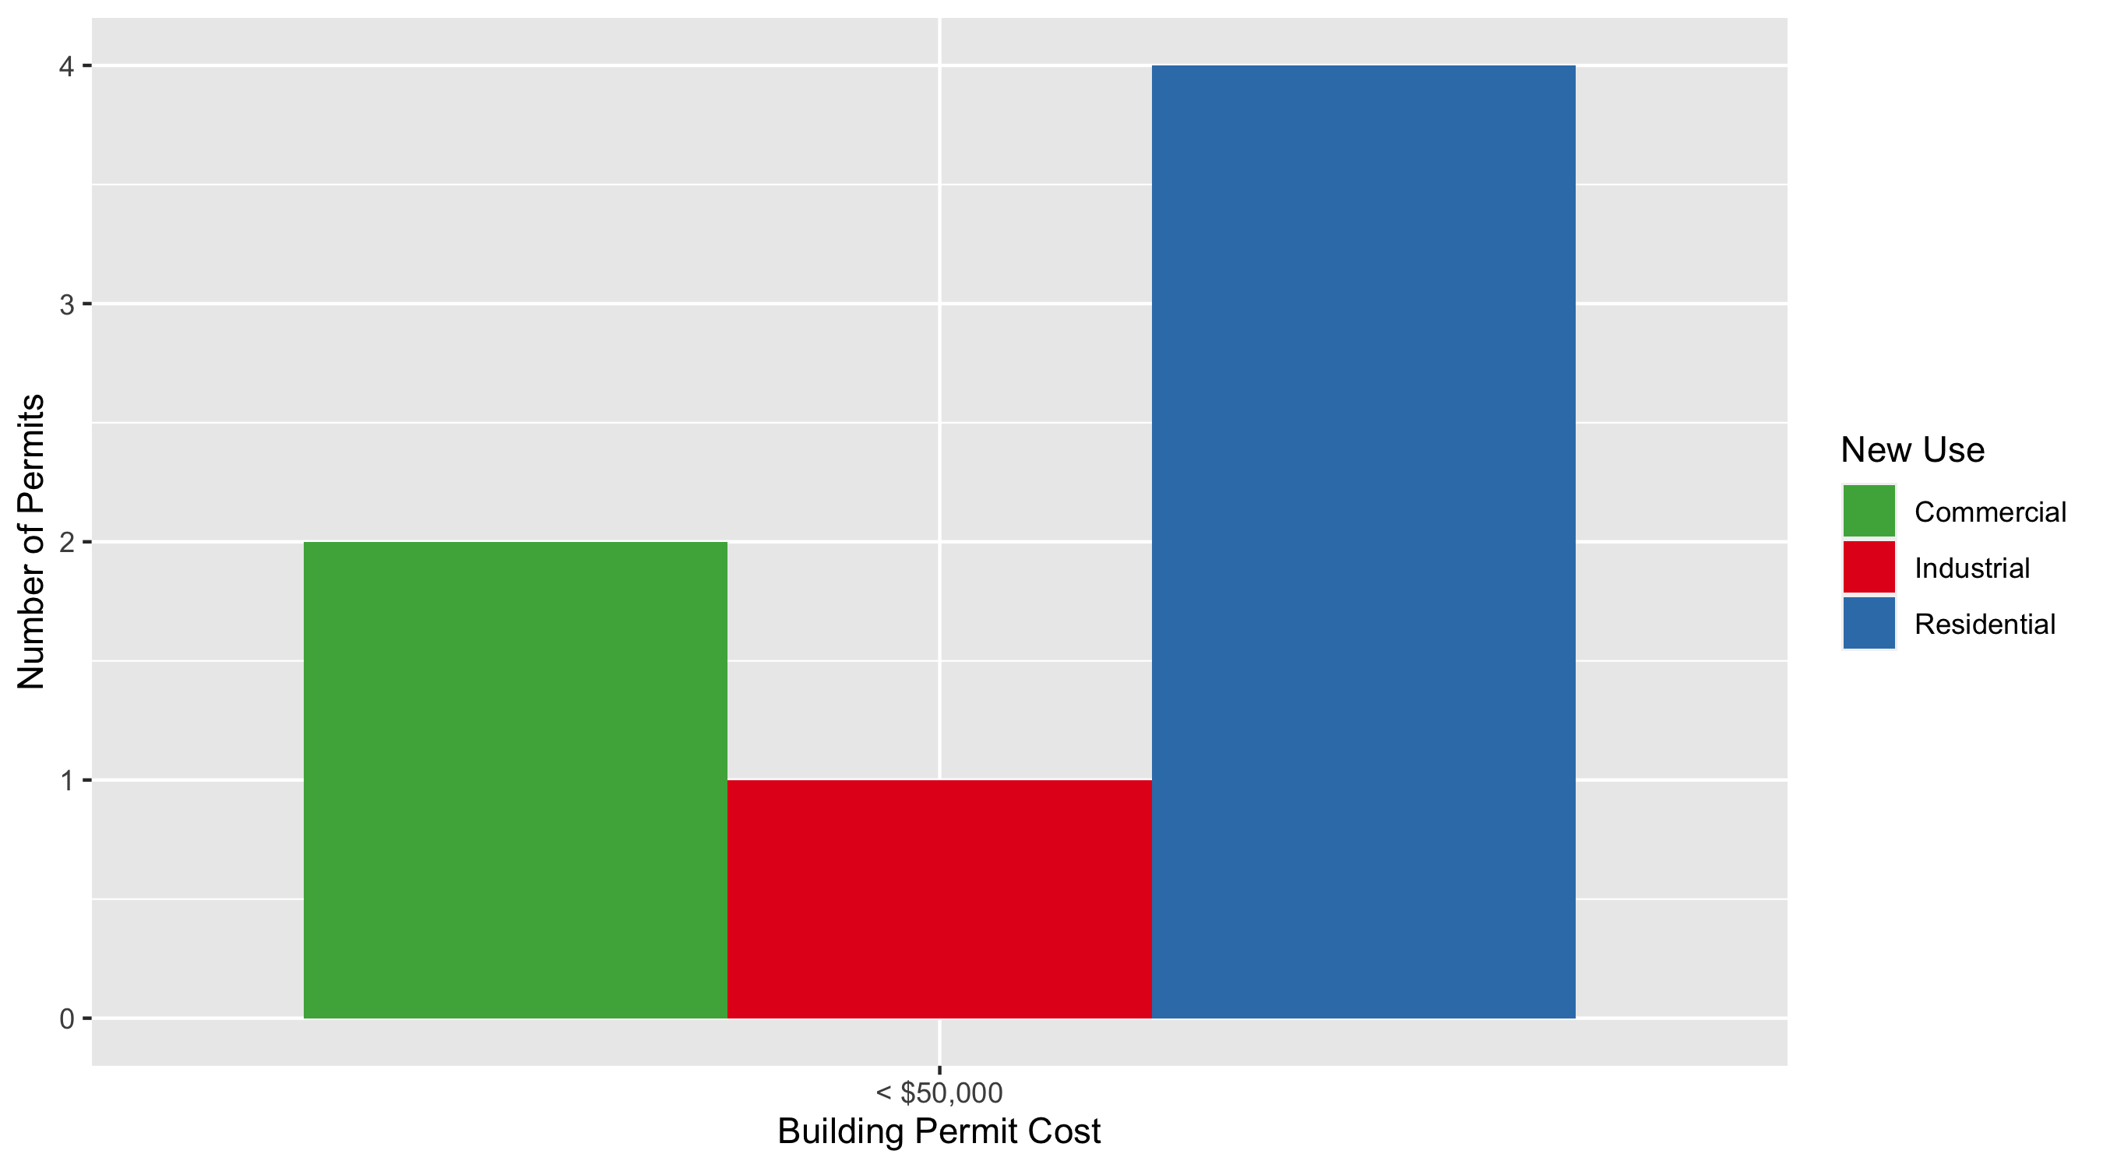
Skinker DeBaliviere Permit Cost Breakdown

Slide 21
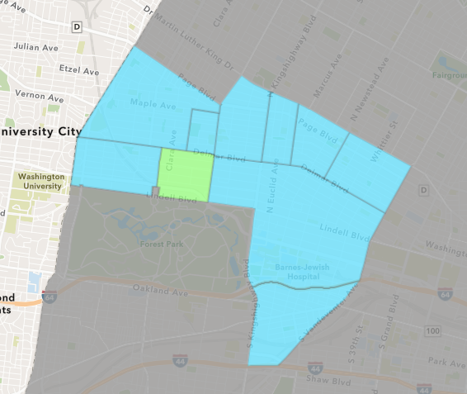
DeBaliviere Place
August 2021 Neighborhood Cost Breakdown
Mean: $16,418
Median: $7,592
Range: $1,000 - $49,490

Slide 22
DeBaliviere Place: Summary Notes
4 building permits in August 2021
-20.00% change compared to August 2020 (5 total building permits)
$16,418: Average building permit cost in August 2021
-76.02% change compared to August 2020 ($68,472)
38 total building permits in 2021
65.22% change YTD compared to this time in 2020 (23 total building permits)
$89,515: YTD average building permit cost in 2021
-45.88% change YTD compared to this time in 2020 ($165,397)

Slide 23
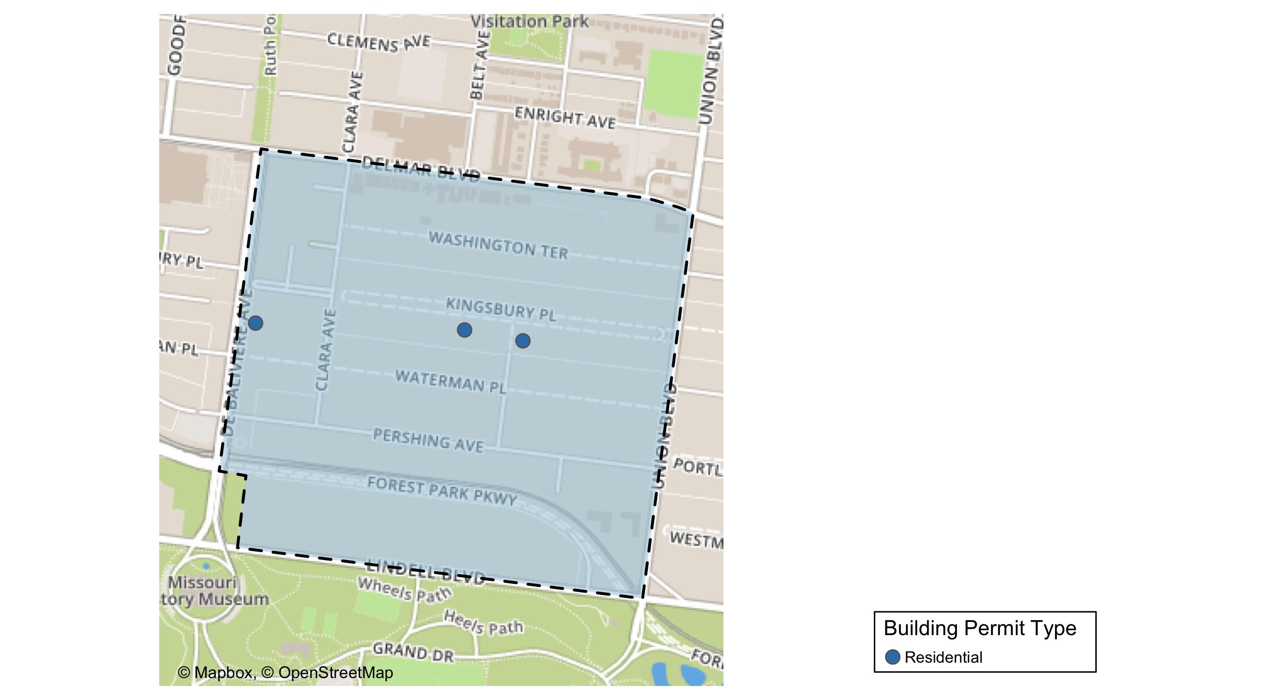
DeBaliviere Place

Slide 24
Neighborhood Summary
August 2021 | August 2021 | August 2021 | August 2021
Permit Use | Average Cost | # of Permits | Total Value of Permits
Commercial | $0.0 | 0 | $0
Industrial | $0.0 | 0 | $0
Residential | $16,418.5 | 4 | $65,674
Last 6 Months | Last 6 Months | Last 6 Months | Last 6 Months
Permit Use | Average Cost | # of Permits | Total Value of Permits
Commercial | $33,466.0 | 6 | $200,796
Industrial | $34,500.0 | 3 | $103,500
Residential | $218,815.9 | 71 | $15,535,927

Slide 25
DeBaliviere Place Individual Permit Breakdown
nbhd_name | Owner | New Use | Cost | address
DeBaliviere Place | HURLEY, MARIA YADIRA & JOHN L PRATER | Residential | $49,490 | 34 KINGSBURY PL
DeBaliviere Place | HUDSON KILAMANJARO V LLC | Residential | $1,000 | 5655 PERSHING AV
DeBaliviere Place | GREGORY, PETER | Residential | $12,000 | 22 KINGSBURY PL
DeBaliviere Place | TSAI, MAX & JILING | Residential | $3,184 | 5696 KINGSBURY AV

Slide 26
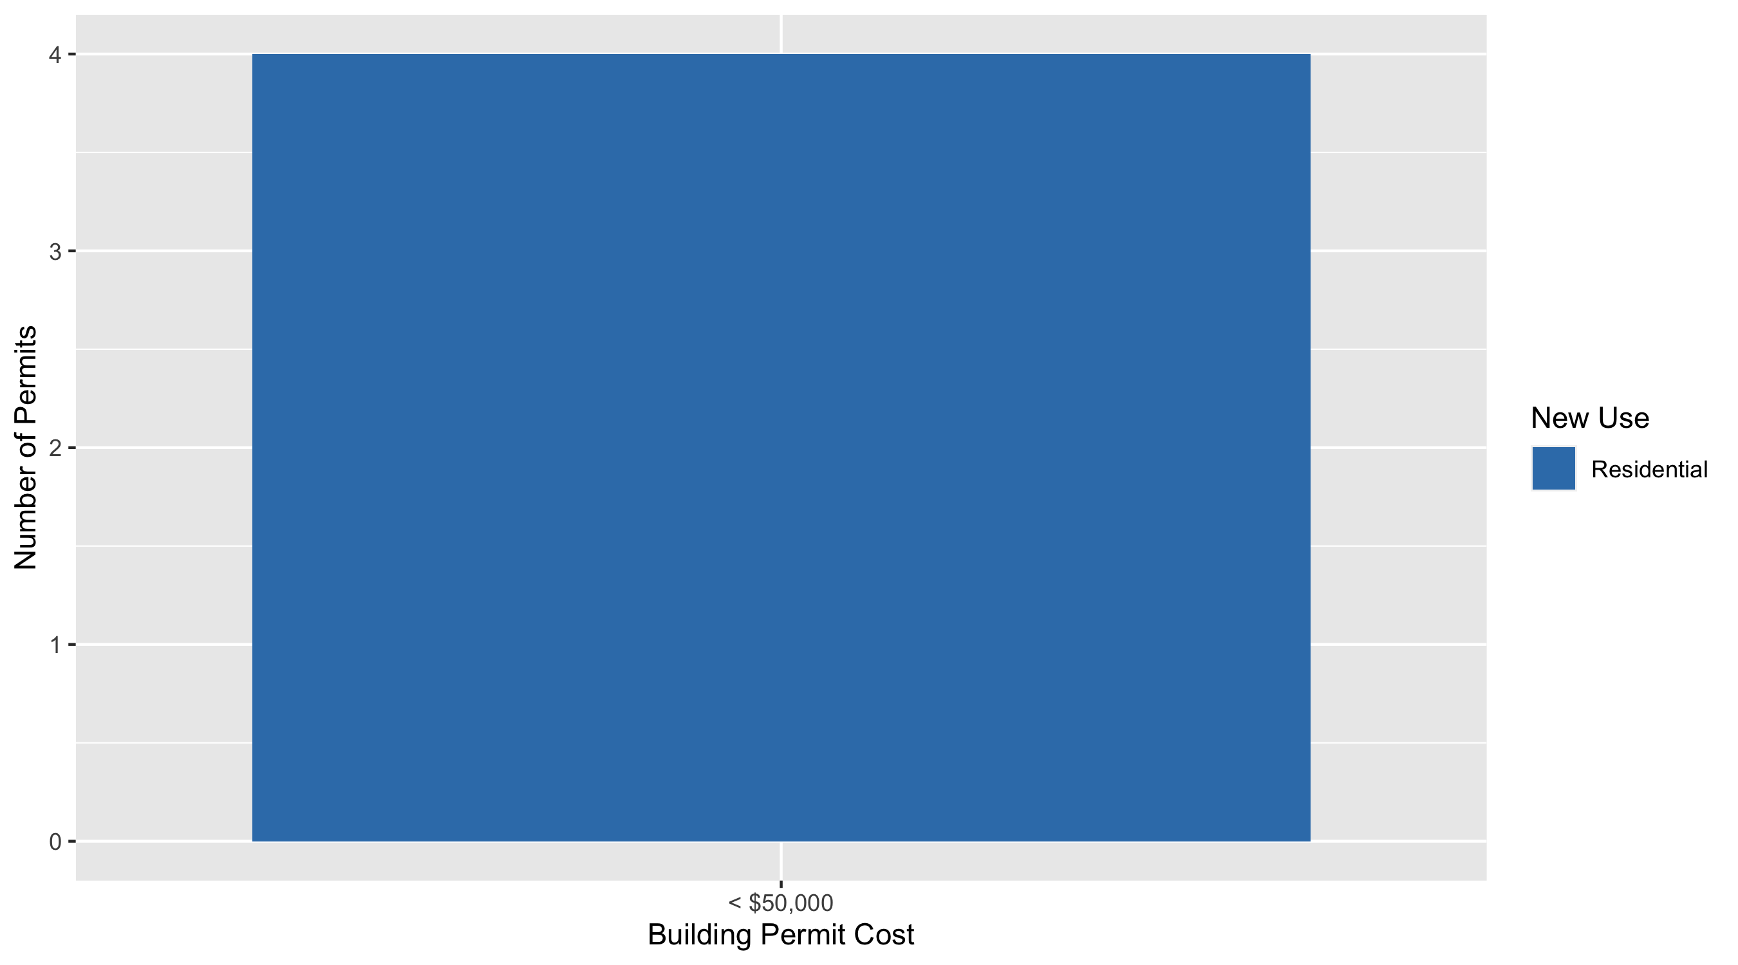
DeBaliviere Place Permit Cost Breakdown

Slide 27
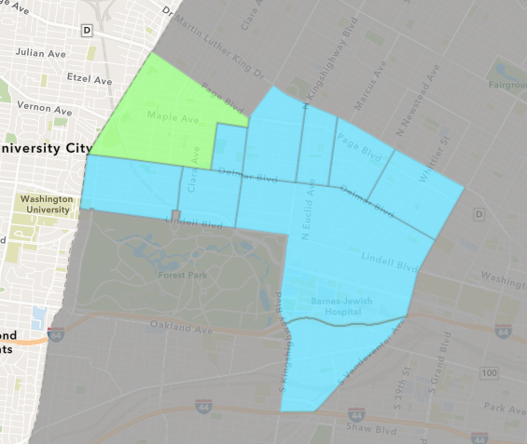
West End
August 2021 Neighborhood Cost Breakdown
Mean: $51,371
Median: $40,000
Range: $48 - $225,000

Slide 28
West End: Summary Notes
20 building permits in August 2021
400.00% change compared to August 2020 (4 total building permits)
$51,371: Average building permit cost in August 2021
-16.82% change compared to August 2020 ($61,759)
98 total building permits in 2021
92.16% change YTD compared to this time in 2020 (51 total building permits)
$89,367: YTD average building permit cost in 2021
-74.58% change YTD compared to this time in 2020 ($351,551)

Slide 29
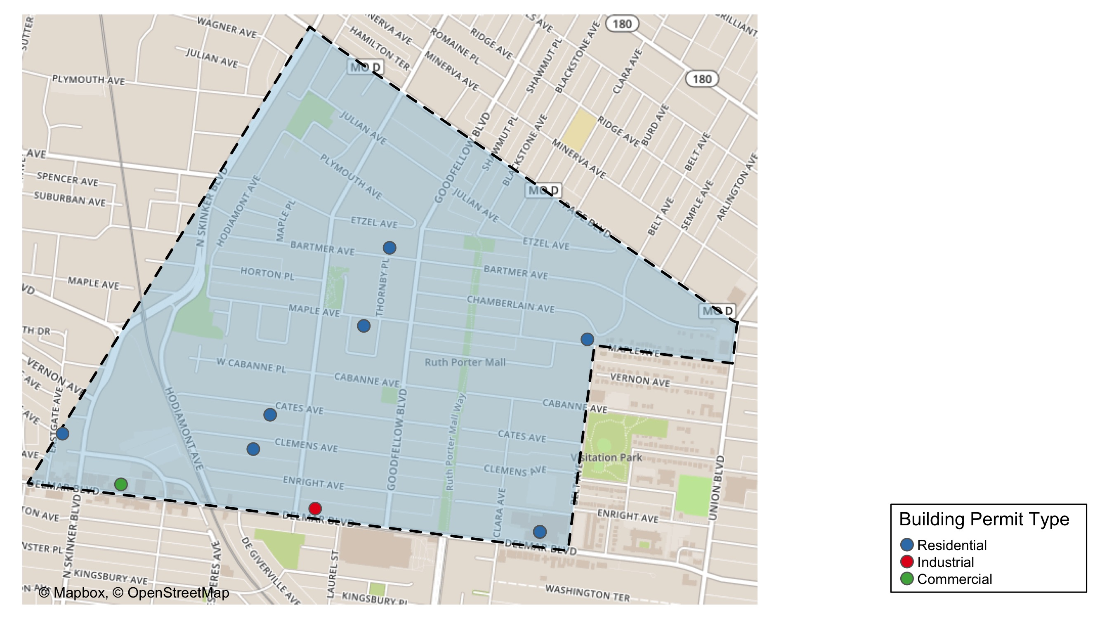
West End

Slide 30
Neighborhood Summary
August 2021 | August 2021 | August 2021 | August 2021
Permit Use | Average Cost | # of Permits | Total Value of Permits
Commercial | $59,000.00 | 12 | $708,000
Industrial | $8,263.00 | 1 | $8,263
Residential | $44,449.71 | 7 | $311,148
Last 6 Months | Last 6 Months | Last 6 Months | Last 6 Months
Permit Use | Average Cost | # of Permits | Total Value of Permits
Commercial | $335,969.56 | 43 | $14,446,691
Industrial | $15,463.46 | 13 | $201,025
Residential | $177,099.38 | 106 | $18,772,534

Slide 31
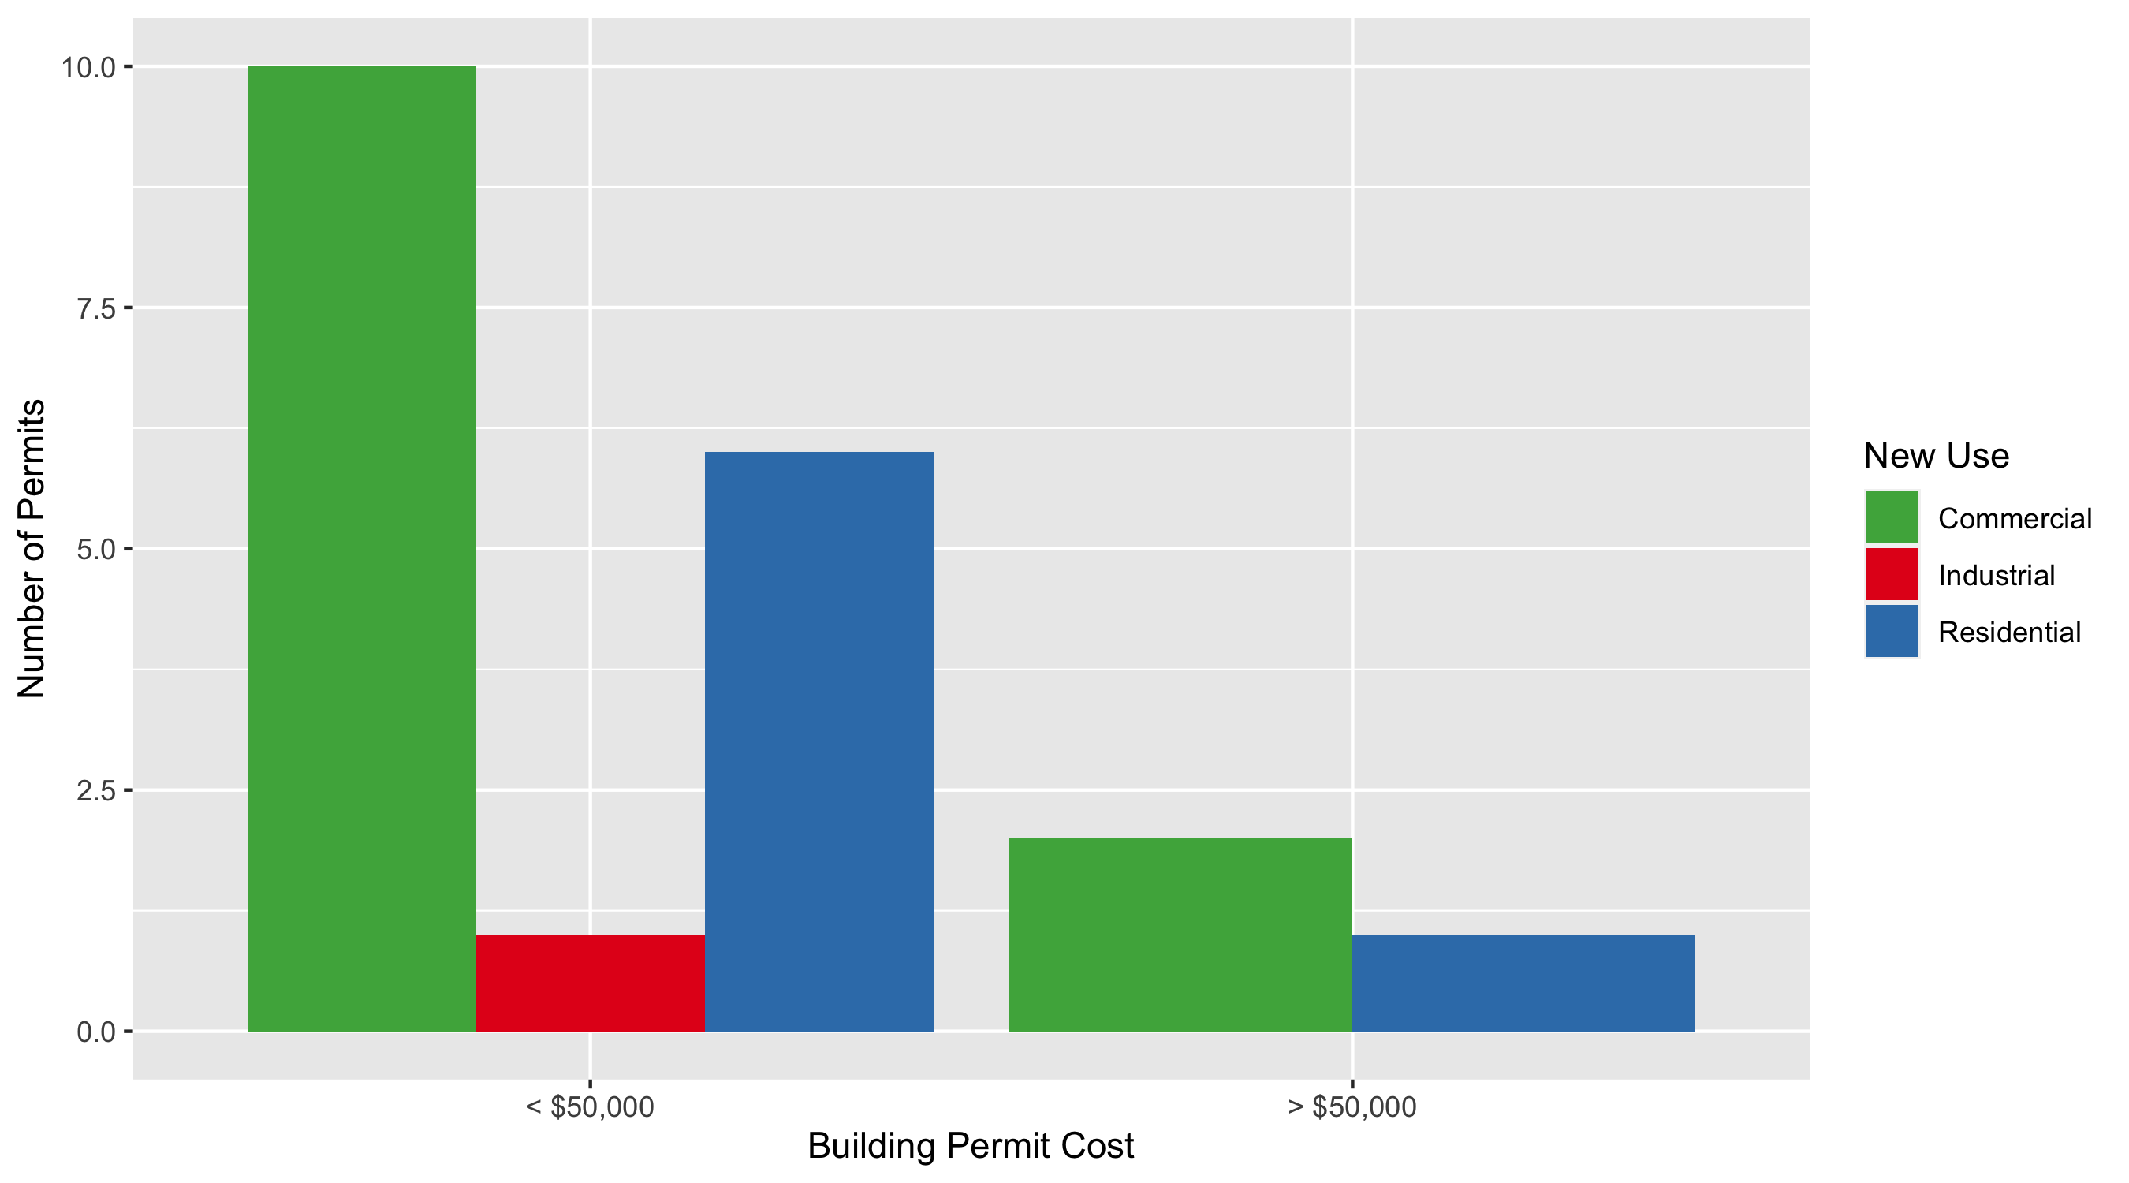
West End Permit Cost Breakdown

Slide 32
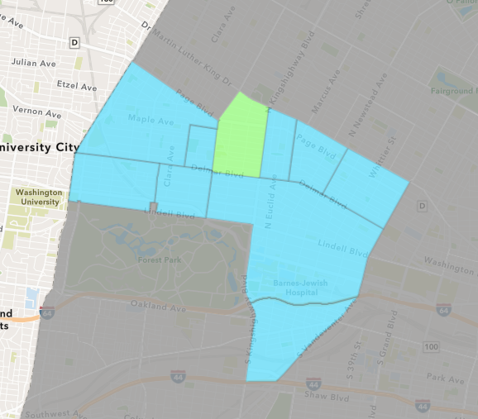
Academy
August 2021 Neighborhood Cost Breakdown
Mean: $32,558
Median: $15,316
Range: $600 - $99,000

Slide 33
Academy: Summary Notes
4 building permits in August 2021
100.00% change compared to August 2020 (2 total building permits)
$32,558: Average building permit cost in August 2021
442.63% change compared to August 2020 ($6,000)
19 total building permits in 2021
-9.52% change YTD compared to this time in 2020 (21 total building permits)
$46,110: YTD average building permit cost in 2021
-16.87% change YTD compared to this time in 2020 ($55,467)

Slide 34
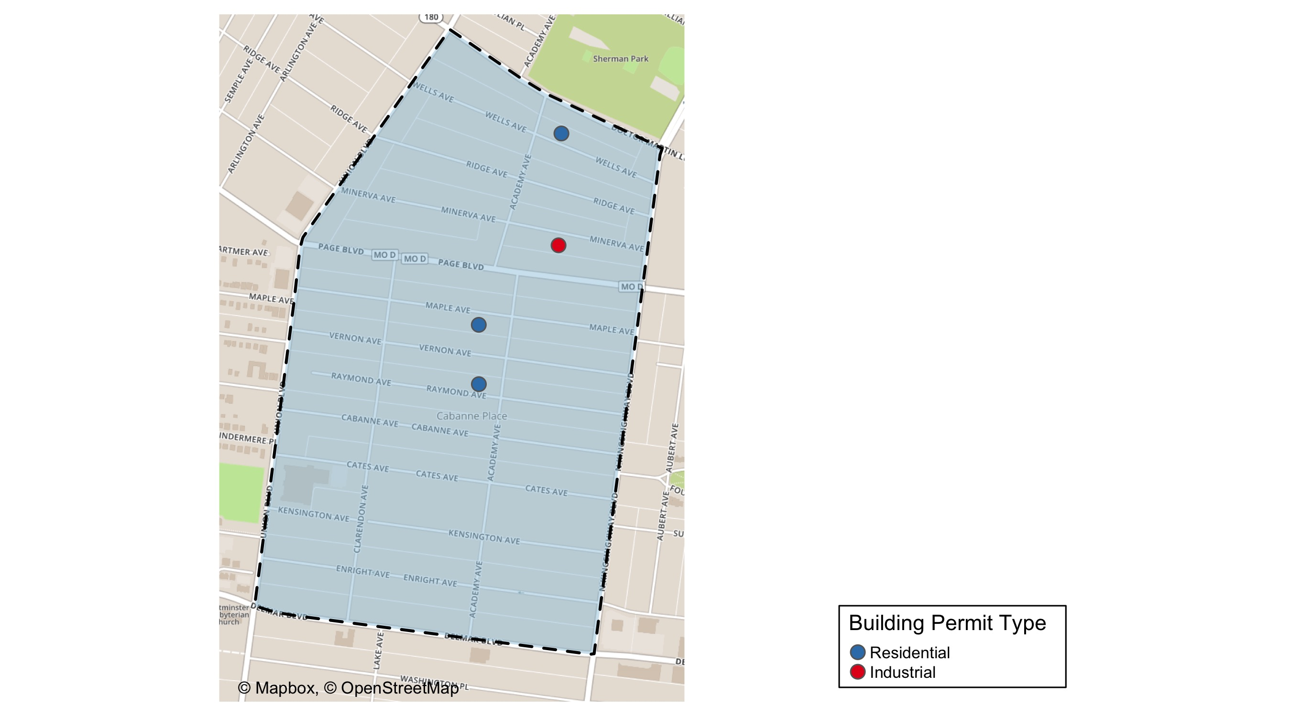
Academy

Slide 35
Neighborhood Summary
August 2021 | August 2021 | August 2021 | August 2021
Permit Use | Average Cost | # of Permits | Total Value of Permits
Commercial | $0.00 | 0 | $0
Industrial | $600.00 | 1 | $600
Residential | $43,210.67 | 3 | $129,632
Last 6 Months | Last 6 Months | Last 6 Months | Last 6 Months
Permit Use | Average Cost | # of Permits | Total Value of Permits
Commercial | $31,250.00 | 4 | $125,000
Industrial | $2,410.00 | 5 | $12,050
Residential | $47,000.61 | 41 | $1,927,025

Slide 36
Academy Individual Permit Breakdown
nbhd_name | Owner | New Use | Cost | address
Academy | RUDOAS URBAN UTOPIA LLC | Residential | $99,000 | 5120 MAPLE AV
Academy | SMITH-MASON, JASMINE & MARILYN SMITH | Residential | $23,423 | 5085 WELLS AV
Academy | DUNN, SHAWN L | Residential | $7,209 | 5119 RAYMOND AV
Academy | LANE-NORFUL, KATHY | Industrial | $600 | 5068 MINERVA AV

Slide 37
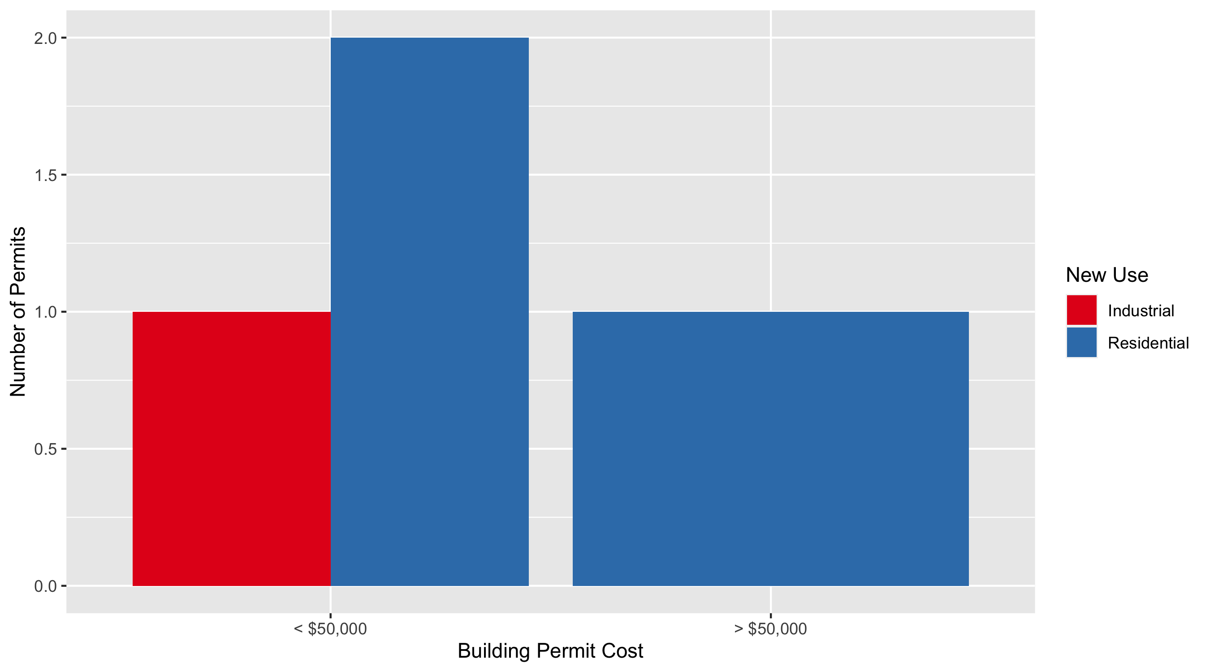
Academy Permit Cost Breakdown

Slide 38
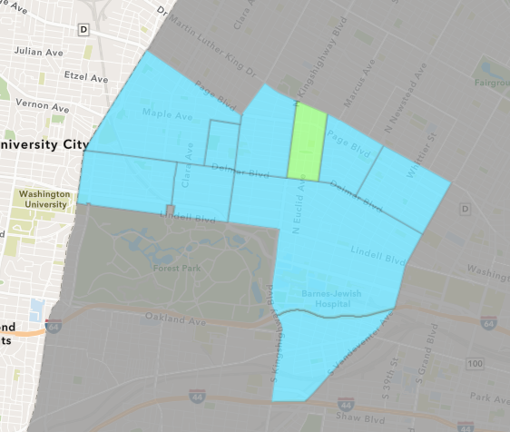
Fountain Park
August 2021 Neighborhood Cost Breakdown
Mean: $45,845
Median: $45,845
Range: $19,690 - $72,000

Slide 39
Fountain Park: Summary Notes
2 building permits in August 2021
100.00% change compared to August 2020 (1 total building permits)
$45,845: Average building permit cost in August 2021
358.45% change compared to August 2020 ($10,000)
14 total building permits in 2021
250.00% change YTD compared to this time in 2020 (4 total building permits)
$466,211: YTD average building permit cost in 2021
7835.51% change YTD compared to this time in 2020 ($5,875)

Slide 40
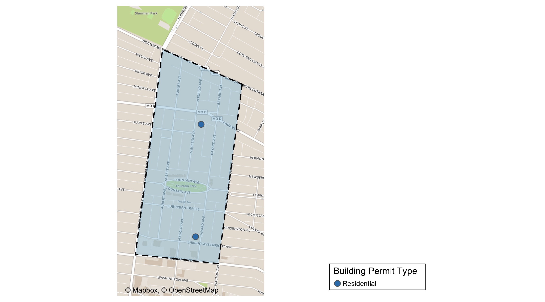
Fountain Park

Slide 41
Neighborhood Summary
August 2021 | August 2021 | August 2021 | August 2021
Permit Use | Average Cost | # of Permits | Total Value of Permits
Commercial | $0 | 0 | $0
Industrial | $0 | 0 | $0
Residential | $45,845 | 2 | $91,690
Last 6 Months | Last 6 Months | Last 6 Months | Last 6 Months
Permit Use | Average Cost | # of Permits | Total Value of Permits
Commercial | $1,279,953 | 5 | $6,399,764
Industrial | $27,500 | 2 | $55,000
Residential | $23,130 | 13 | $300,690

Slide 42
Fountain Park Individual Permit Breakdown
nbhd_name | Owner | New Use | Cost | address
Fountain Park | BOWERS, MONICA & PAYTON SUTHERLIN | Residential | $72,000 | 1254 N EUCLID AV
Fountain Park | PATE, DOROTHY A | Residential | $19,690 | 749 BAYARD AV

Slide 43
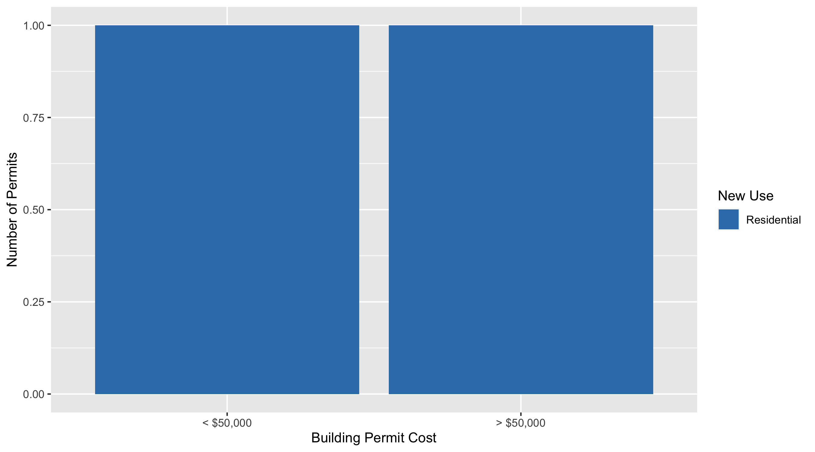
Fountain Park Permit Cost Breakdown

Slide 44
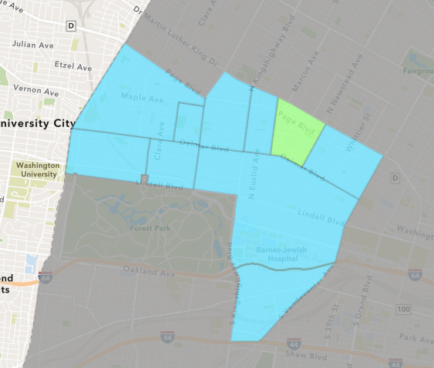
Lewis Place
August 2021 Neighborhood Cost Breakdown
Mean: $369,779
Median: $209,336
Range: $10,000 - $890,000

Slide 45
Lewis Place: Summary Notes
3 building permits in August 2021
200.00% change compared to August 2020 (1 total building permits)
$369,779: Average building permit cost in August 2021
6093.95% change compared to August 2020 ($5,970)
13 total building permits in 2021
225.00% change YTD compared to this time in 2020 (4 total building permits)
$98,031: YTD average building permit cost in 2021
5778.92% change YTD compared to this time in 2020 ($1,668)

Slide 46
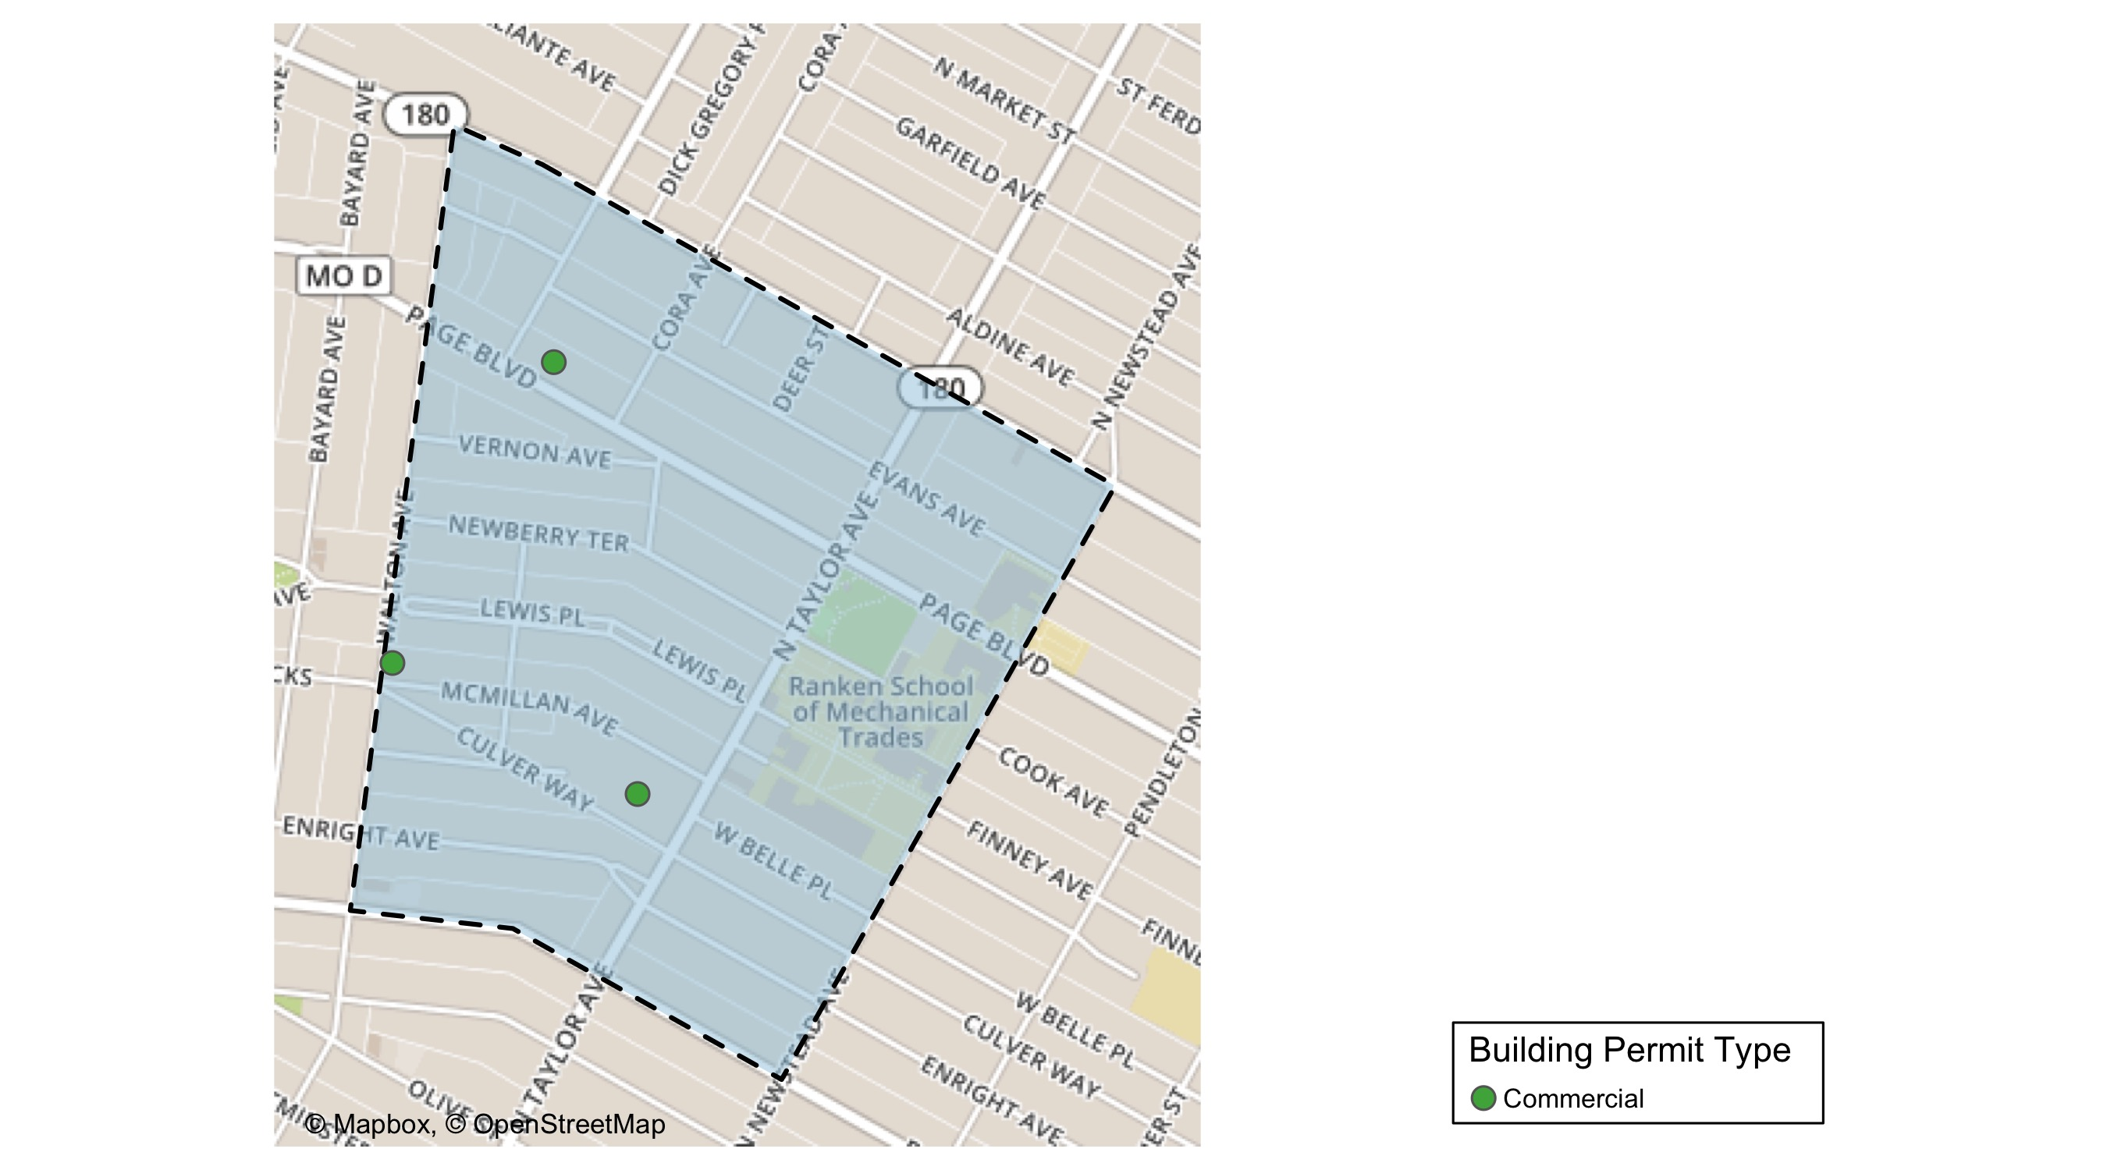
Lewis Place

Slide 47
Neighborhood Summary
August 2021 | August 2021 | August 2021 | August 2021
Permit Use | Average Cost | # of Permits | Total Value of Permits
Commercial | $369,778.7 | 3 | $1,109,336
Industrial | $0.0 | 0 | $0
Residential | $0.0 | 0 | $0
Last 6 Months | Last 6 Months | Last 6 Months | Last 6 Months
Permit Use | Average Cost | # of Permits | Total Value of Permits
Commercial | $225,867.20 | 5 | $1,129,336
Industrial | $18,733.33 | 3 | $56,200
Residential | $24,945.58 | 19 | $473,966

Slide 48
Lewis Place Individual Permit Breakdown
nbhd_name | Owner | New Use | Cost | address
Lewis Place | LRA | Commercial | $10,000 | 4755 MCMILLAN AV
Lewis Place | WEST SIDE MISSIONARY BAPTIST CHURCH | Commercial | $890,000 | 4675 PAGE BLVD
Lewis Place | HOPEWELL MISS BAP CHURCH | Commercial | $209,336 | 915 N TAYLOR AV

Slide 49
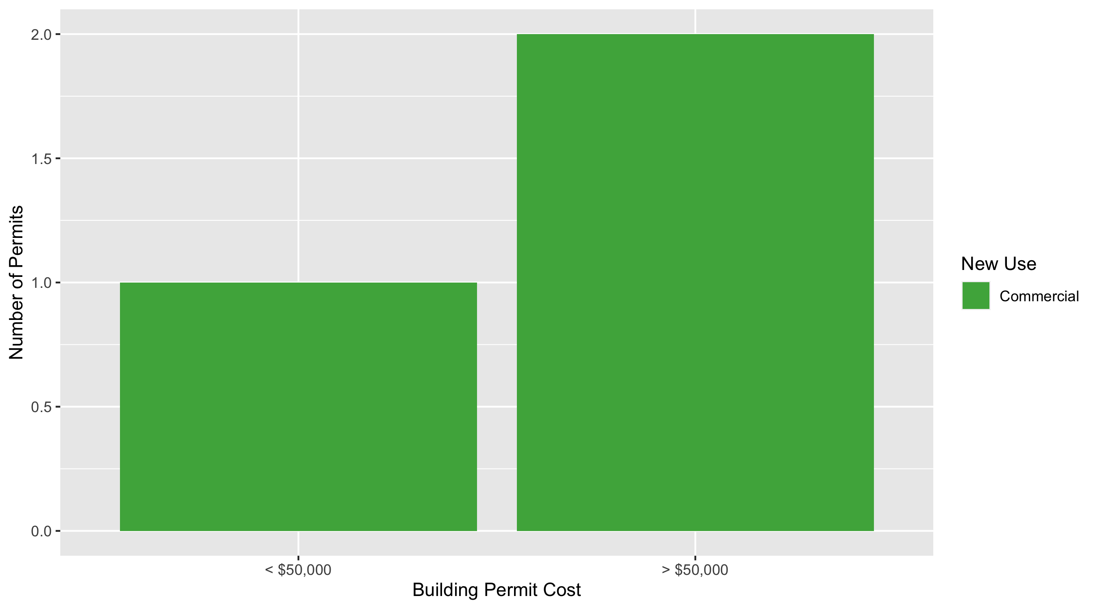
Lewis Place Permit Cost Breakdown

Slide 50
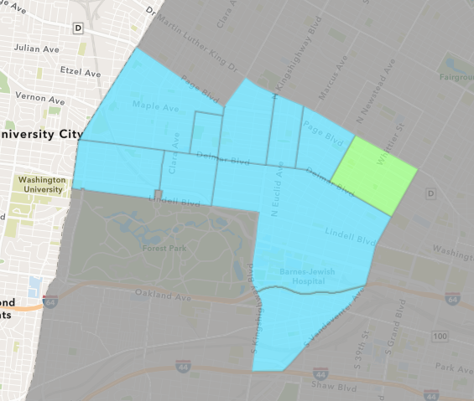
Vandeventer
August 2021 Neighborhood Cost Breakdown
Mean: $101,750
Median: $102,000
Range: $3,000 - $200,000

Slide 51
Vandeventer: Summary Notes
4 building permits in August 2021
300.00% change compared to August 2020 (1 total building permits)
$101,750: Average building permit cost in August 2021
-18.60% change compared to August 2020 ($125,000)
8 total building permits in 2021
0.00% change YTD compared to this time in 2020 (8 total building permits)
$62,038: YTD average building permit cost in 2021
28.22% change YTD compared to this time in 2020 ($48,385)

Slide 52
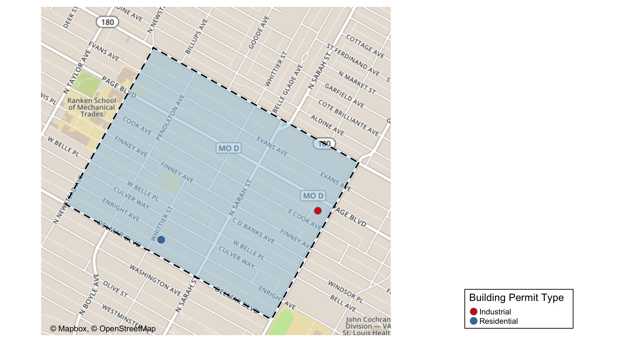
Vandeventer

Slide 53
Neighborhood Summary
August 2021 | August 2021 | August 2021 | August 2021
Permit Use | Average Cost | # of Permits | Total Value of Permits
Commercial | $0.0 | 0 | $0
Industrial | $4,000.0 | 1 | $4,000
Residential | $134,333.3 | 3 | $403,000
Last 6 Months | Last 6 Months | Last 6 Months | Last 6 Months
Permit Use | Average Cost | # of Permits | Total Value of Permits
Commercial | $28,223.00 | 3 | $84,669
Industrial | $3,650.00 | 2 | $7,300
Residential | $58,382.22 | 18 | $1,050,880

Slide 54
Vandeventer Individual Permit Breakdown
nbhd_name | Owner | New Use | Cost | address
Vandeventer | RANKEN TECHNICAL COLLEGE | Residential | $200,000 | 4373 EVANS AV
Vandeventer | RANKEN TECHNICAL COLLEGE | Residential | $200,000 | 4377 EVANS AV
Vandeventer | MARTIN, JAMES T JR & MWJT HOMES LLC | Industrial | $4,000 | 1220 JONES ST
Vandeventer | 5 STAR REALTY LLC | Residential | $3,000 | 4184 ENRIGHT AV

Slide 55
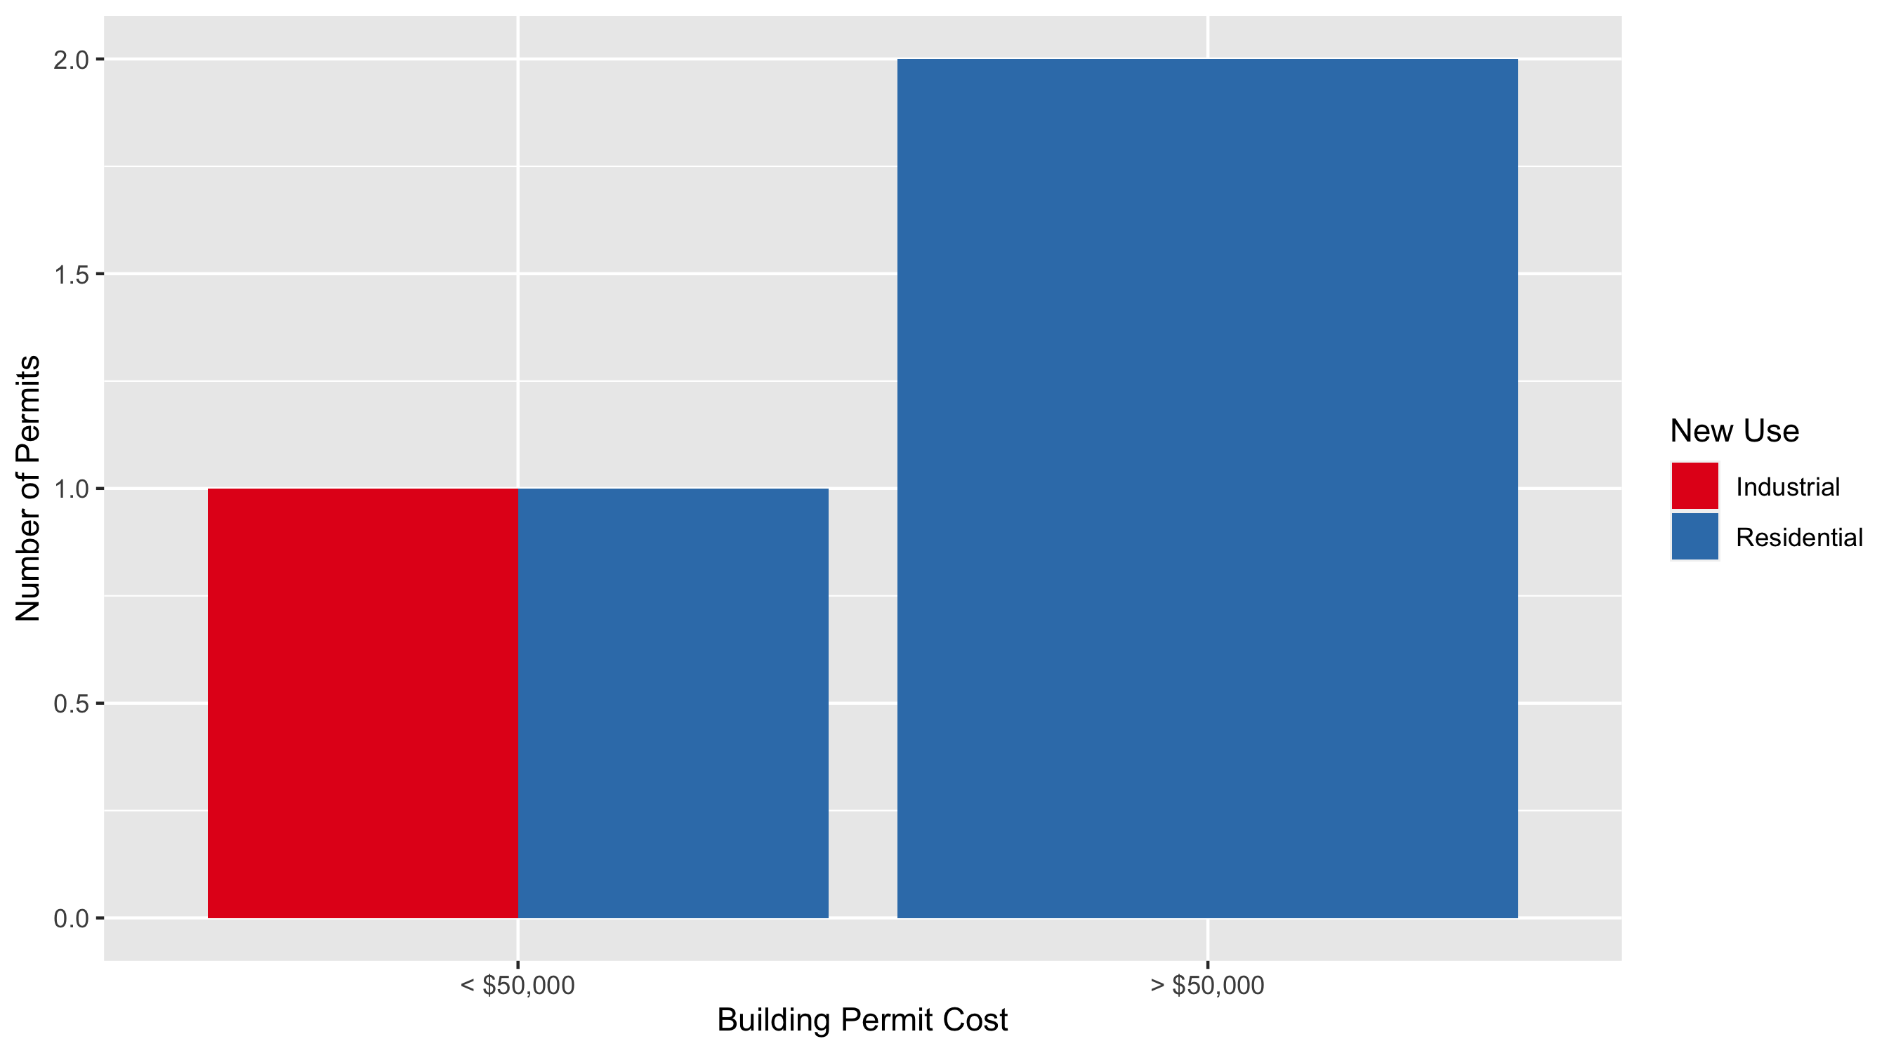
Vandeventer Permit Cost Breakdown

Slide 56
Additional Notes
Data retreived from https://www.stlouis-mo.gov/data/
Building permits with a cost of $0 were dropped
Building permits that were cancelled were dropped
Infinite change indicates 0 permits in the current or previous time period/comparison month so there was a overall increase or decrease

